Slide 1
Rational Rose Tutorial
Computer Systems Technology
BCIT

Slide 2
Overview
CASE
ROSE Concepts
Class diagrams
Sequence diagrams
Managing model complexity
Document generation
Code generation

Slide 3
CASE
How do we keep models and code consistent?
Need for Computer Aided Software Engineering (CASE)
  A CASE tool supports parts or all activities of the software lifecycle
Front-end CASE tools:
  Tools that create only object models
Back-end CASE tools
  Netbeans, Borland Jbuilder, IBM VisualAge are development environments
Documentation is usually supported by separate tools
  Microsoft Word, PowerPoint, ....
Lifecycle CASE tool: Supports analysis, design, implementation and documentation
  Rational Rose Software

Slide 4
ROSE Concepts
ROSE enables the user to:
  construct an object model of a system
  draw diagrams representing different views of the model
  generate code (example Java)
ROSE distinguishes between an entity ( model element) and its representation (icon):
  there can be only one model element (e.g., a class) with a given name
  a model element (e.g., class Customer) can be represented by many icons in many different diagrams
  Deleting an icon from a diagram does not always delete the model element

Slide 5
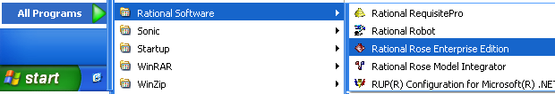
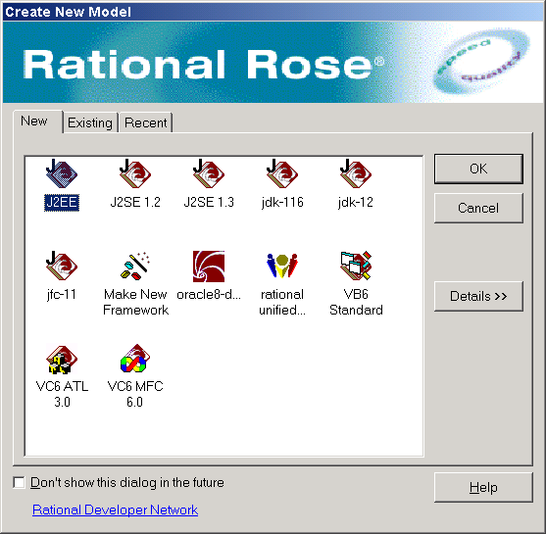
Create New Model screen
Step 1
Start Rational Rose
Step 2
Start a new Model
Click on cancel

Slide 6
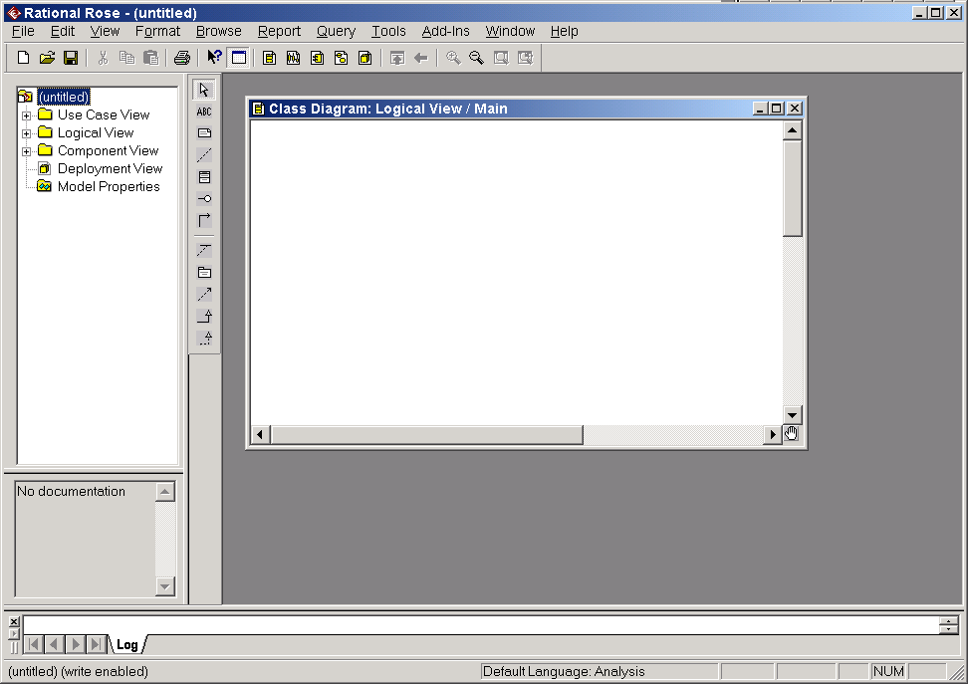
ROSE Windows
Step 3
Browser
Toolbar
Document Window
Diagram area
Diagram Toolbar

Slide 7
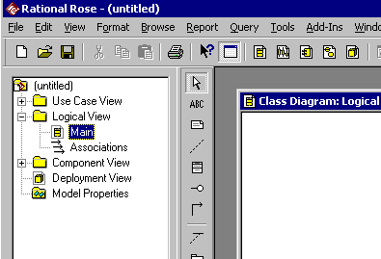
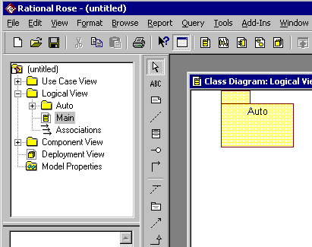
Creating a package
Step 4
Step 5
Double
Click
Click on the package icon in the toolbar and then click on the diagram
Rename the package to “Auto”

Slide 8
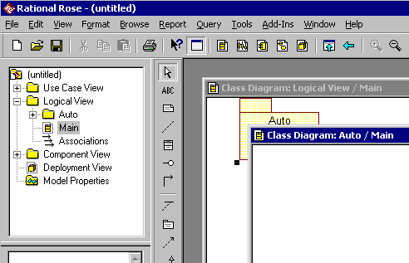
Creating classes belonging to a package
Double-click on the “Auto” package.
Step 6
Notice a class diagram named “Main” is automatically created under that package.

Slide 9
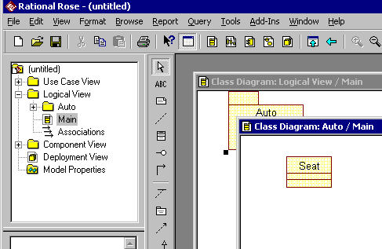
Creating a new class
Step 7
Click on the class tool in the diagram toolbar
Click on the class diagram
Type the name of the class (e.g., “Seat”)
Resize the class symbol

Slide 10
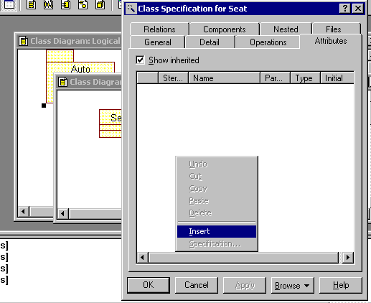
Adding Attributes
Step 8
2. Click on the “Attributes” tab
1. Double click on the “Seat” class
3. Right click on the blank area
4. Select “Insert” menu item

Slide 11
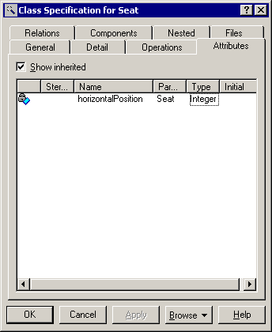
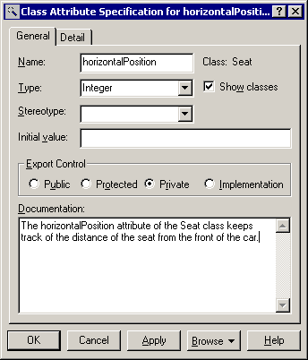
Add attribute (continued)
Step 9
3. Double click on the new attribute
1. Enter attribute name
2. Enter attribute type
Type attribute documentation then click on “OK”

Slide 12
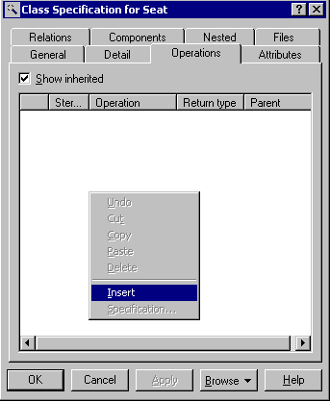
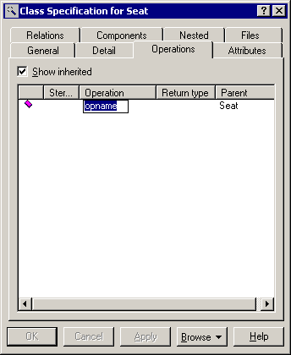
Add operation
Step 10
Step 11
1. Click on the “Operations” tab
2. Right click on blank area
Double click on the new operation
3. Select “Insert”

Slide 13
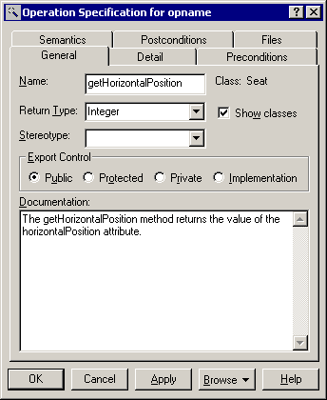
Add operation (continued)
Step 12
Type its signature, return type, and documentation,
Click “OK”
Click “OK” one more time to return to the class diagram

Slide 14
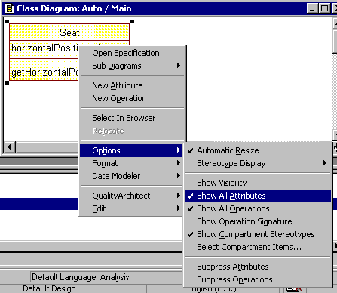
Showing and hiding properties
Step 13
Right click on the “Seat” class and select “Options”
Disable
  “Show All Attributes”
  “Show All Operations”
  “Show Visibility”
The default values for these check marks can be set on the “Diagram” tab by selecting “Options” from the “Tools” menu.

Slide 15
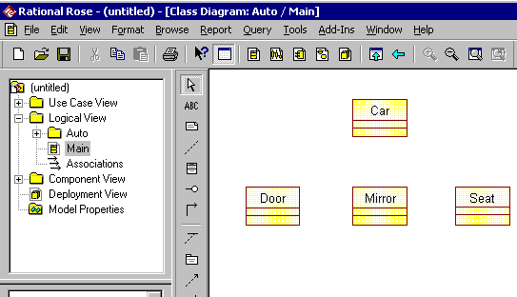
Creating More Classes
Step 14
Create the additional classes:
Car
Door
Mirror

Slide 16
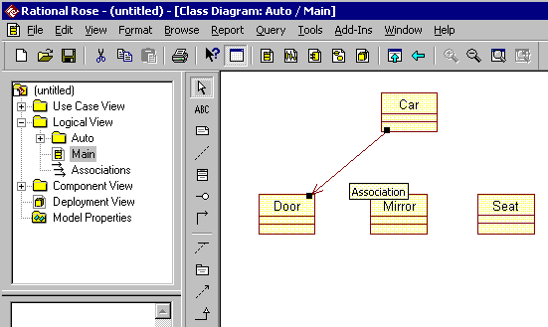
Creating associations
Step 15
2. Drag the “Unidirectional Association” from source class (e.g. “Door”) to the target class (e.g. “Car”)
1. Click on the “Unidirectional Association” tool.

Slide 17
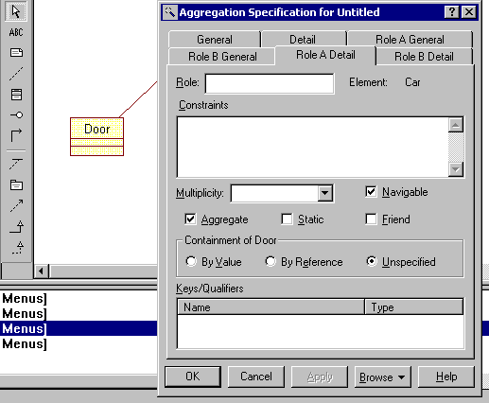
Creating associations (continued)
Role A Detail and Role B Detail are important to set the shape of the arrow and the direction of it.
Step 16
Double click on the
association to change its
attributes
name
roles
cardinality
Change the head of the arrow to diamond
If it is navigable has an arrow head if it is not the arrow head is removed

Slide 18
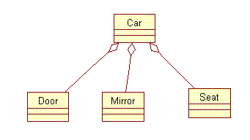
Creating associations (continued)
Step 17
Complete the above associations by repeating steps 15 and 16.

Slide 19
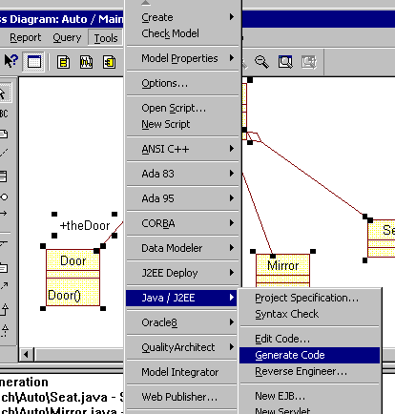
Code Generation with ROSE:
Generating Java code
Step 18
Select the classes whose code is to be generated
Select “Generate Code” from “Tools / Java-J2EE”

Slide 20
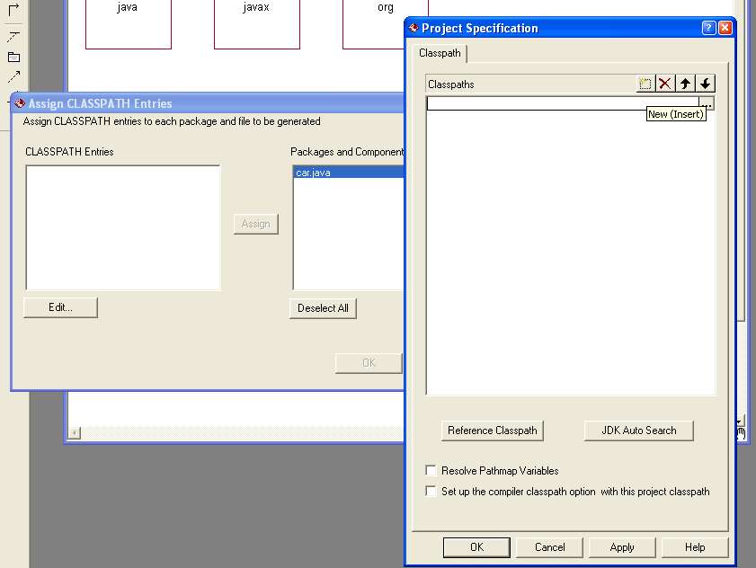
Code Generation with ROSE:
Generating Java code
Step 19
Assign a “Classpath” which essentially means a folder on your hard drive that will contain the Java classes
Select “Edit Code” to view the Java code, after is generated.
  Hint: do not modify the comments generated by ROSE (e.g., //##begin ...)

Slide 21
Typical process for using Rational Rose
Create actors and use cases, including their brief descriptions
Draw use case diagrams
Create a class diagram per use case for displaying its participating objects.
  Create or include the classes
  Create any additional relationships
Create a sequence diagram per use case
  Include each participating object
  Create messages
  Create operations
  Bind messages and operations
Organize classes into packages
Generate code and documentation

Slide 22
Things to remember
In Rose, names are unique across the model, for example:
  An actor and a class cannot have the same name
  A use case and a class cannot have the same name
Most text strings can be edited by double clicking on them
Specifications (properties of class, use case, actor) can be displayed by double clicking on the corresponding icon
Items can be inserted and removed from list by right clicking on the list. This applies to
  Attributes and operations
  Diagrams associated with a use case
On-line help provides more information than the manual
Backup your files, PCs crash frequently

